Slide 1
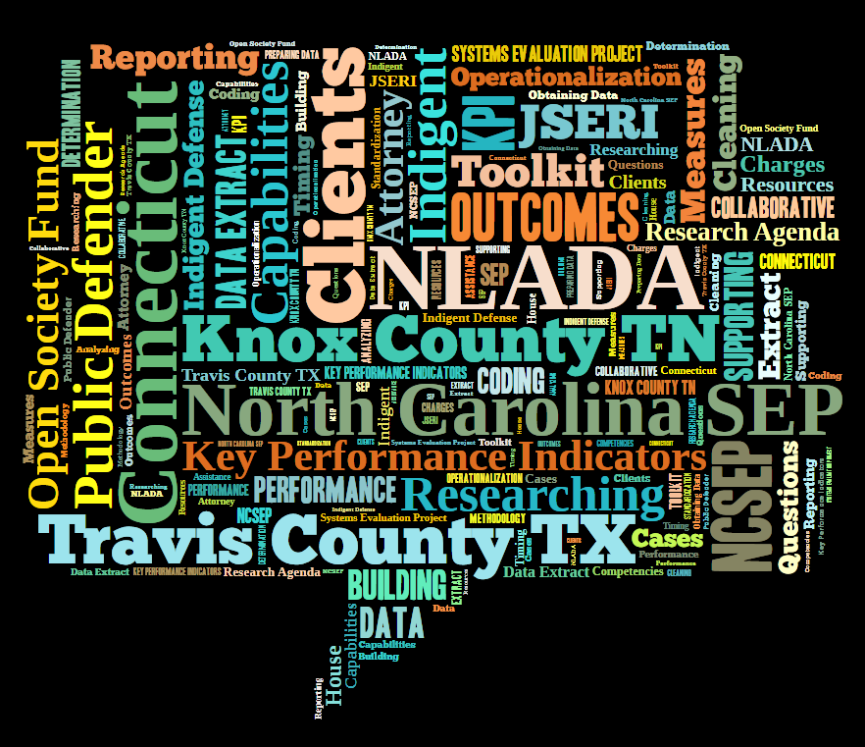
Where do We Begin and
How do We Avoid Common Mistakes?
Connecticut Division of Public Defender Services
Annual Meeting of the American Society of Criminology
Friday, November 21, 2014

Slide 2
Connecticut: Our Story
Factors to Consider
What you can do Differently

Slide 3
Connecticut: Our Story
Overview of Connecticut Division of Public Defender Services:
Statewide Indigent Defense System established by statute in 1975
Governed by a seven member Commission
Autonomous body within the State Judicial Department
400+ employees
Offices in 13 Judicial District Courts, 20 Geographical Area Courts, 13 Juvenile Matters Courts and seven specialized units
Assigned Counsel Unit oversees ≈550 Contract Attorneys for Conflict Cases
99,354 cases assigned to Public Defenders and Assigned Counsel during the 2012/13 Fiscal Year
Internal Case Tracking System to monitor caseflow
Information (data collection) department expanded in 2010 to include “Research”
Data collected on all criminal and MV cases within the Judicial Branch/Court Operations’ Criminal Motor Vehicle System (CRMVS). Overseen by the Chief Court Administrator

Slide 4
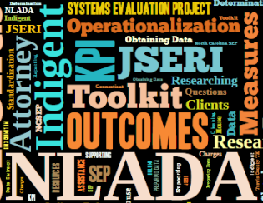
WHY WE JUMPED IN HEADFIRST
We asked to be one of the pilot sites for the along with TN, TX and NC because SEP:
Help us build in-house research capabilities
Fit well with our newly formed research agenda
Supported our belief in creating a network of Indigent Defense researchers who share and collaborate
Could give us the ability to provide evidence-based results to our legislature
Provided expert assistance from NLADA/NCSEP in selecting indicators that reflect our goals and objectives

Slide 5
FACTORS WE SHOULD HAVE CONSIDERED BEFORE WE JUMPED IN HEADFIRST
Available Staff
Technology Capabilities
Existing Projects
TIME
Data Availability
Research Capabilities
Agency Support
State Criminal Justice Initiatives
Agency Priorities
Timing
Notes:
What seems like a great idea, a no-brainer if you will, may never get off the ground because of timing and resources.

Slide 6
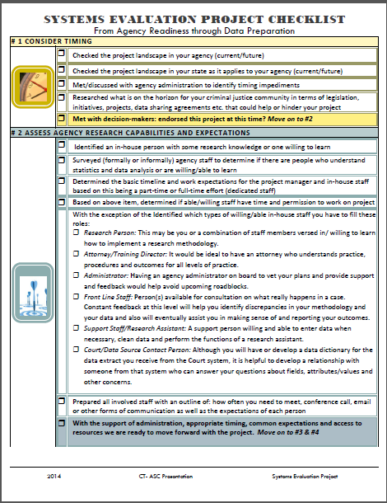
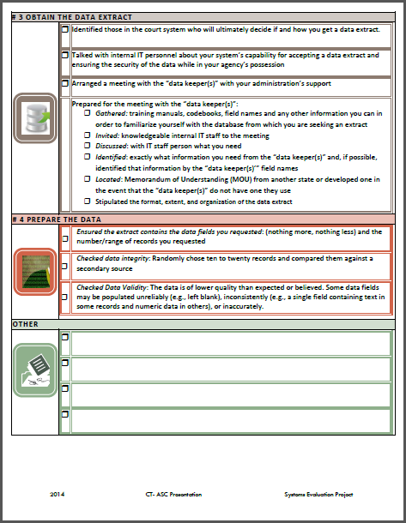
WHAT YOU CAN DO DIFFERENLY
TIMING: Find out where this fits or does not fit within agency, state and CJ projects
CAPABILITIES and RESOURCES: Make sure you have the resources: software, physical space etc. The staff: practice experts, “researcher”, administrative support, clerical support and someone familiar with the data and how it was collected.
EXPECTATIONS: Determine who is able and willing to help with this project, what they bring to the table and how much time they can provide.
Be up front with what you expect of them and the timeline of the project.

Slide 7
YOUR FIRST STEPS
Obtaining the Data Extract
Stake out the right people
Get Support
Arrange a meeting with the “data keepers”
Prepare for the meeting
Preparing the Data
Did you get the number of cases and types of data you requested?
Are the fields consistent with what you requested?
Is the data valid and reliable?

Slide 8
Good Luck!
Reach out with questions and for support:
Jennie Albert, LCSW
Manager of Information Services and Research
Connecticut Division of Public Defender Services
30 Trinity Street, 4th Floor
Hartford, Connecticut 06106
(860) 509-6400
Email: jennie.albert@jud.ct.gov

